Slide 1

Identifying and Collecting NAPs on Prevention against DV and IPV in the 27 European Union Member States: Research Framework and Methods
Prepared by: Deyan Aleksandrov, MSc, Krasimira Aleksandrova, MPH, PhD Association Public Health-99
Notes:
Identifying and collecting of the national action plans (NAPs) on prevention against domestic violence (DV) and intimate partner violence (IPV) in the 27 European Union member states is a key element of the project. Indeed, the overall project output is predefined by the quality, volume, specificity and content of the collected information. Therefore, the choice of reliable methods of identification, collection and analysis of national plans is an important step in the implementation of the project.

Slide 2
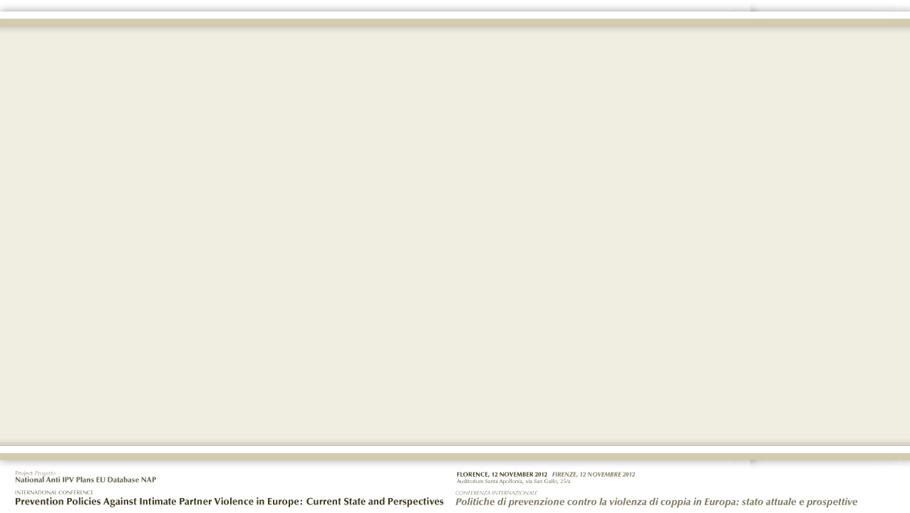
Methods used include:
Analysis of information needs
Specifying and defining search criteria
Selection and evaluation of the sources of information
Choice of search strategies
Assess the relevance of the information
Notes:
The main methods used and the separate stages in the search, identification and collection of national IPV and DV plans include:

Slide 3

1. Analysis of information needs
Action plans, national strategies or other relevant policy documents
Not all EU countries have adopted specific strategies
Difficult to assess effectiveness of different approaches
Often it’s part of a general document dealing with issues such as violence against women as a whole, social exclusion, equal opportunities, etc.
Notes:
Legislative and policy initiatives of the European Commission and the Council of Europe over the past decade have resulted in the development and adoption of action plans, national strategies or other relevant policy documents addressed at preventing DV and IPV in the majority of the EU countries. Despite the political will at European and national level to address the problem, still some European countries have not yet adopted strategic documents concerning DV and IPV. Another problematic point that makes it difficult to assess the effectiveness of different national approaches is the relative heterogeneity of the relevant strategic documents. Often prevention of DV and IPV is part of a general document dealing with issues such as violence against women as a whole, social exclusion, equal opportunities among genders, etc.
From this perspective, identification, collection, analysis and structuring in a separate database of national plans specifically aimed at preventing DV and IPV will contribute to the identification of the problem, taking into account its true size, improve the comparibility of the measures in individual countries and standardization of the achievement criteria.

Slide 4
2. Specifying and defining search criteria
Operational definition of NAPs against DV and IPV
Definition components | Description
Target group | women and children
Coverage | 27 EU member states
Legislative base | Council of Europe Recommendation 1582 ‘Domestic violence against women’
Time framework | 27 September 2002 until 1 June 2012
Information sources | Internet; Websites of national institutions, national and international NGOs
Notes:
IPV relates to a number of behaviors, actions and attitudes by one of the partners or ex-partners that aim to control and dominate the other person. These include assaults, threats or repeated verbal, physical, sexual or economic pressures undermining the integrity of the other person and even their socio-professional integration. Importantly, such a form of violence not only affects the victim him/herself, but also other family members, mostly the children. Therefore, it is also a form of domestic violence. Due to the heterogeneity of the available documents on national level covering the topic, the project team had to agree upon an operational definition for a NAP (Table 1).
For the purpose of this project, the term ‘NAP against DV and IPV’ covers all national plans in the 27 EU member states that are specific to the prevention of DV and IPV against women and children, for which there is available information in Internet. As a main basis for classification of criteria towards which to assess the available NAPs, the project team chose to use the following document: ‘Council of Europe Recommendation 1582 (2002) ‘Domestic violence against women’. The chronological framework of the research includes documents published between the dates of the publication of Council of Europe Recommendation 1582 ‘Domestic violence against women’, 27 September 2002 until 31.12.2011.
Preliminary examination of the available information resources showed that in some European countries there is more than one plan, treating the problems addressed, or a plan that was updated a number of times over a period of several years. For example, in 2001, Belgium developed its first NAP to combat violence against women. Based on the assessment of this first 2001-2003 NAP, a new action plan was drawn up for the 2004-2007 period. Contrary to the first NAP which concerned abusive relationships and sexual violence, violence at work and even human trafficking, the 2004-2007 plan dealt only with intimate partner violence. In 2006, a decision was made to modify the 2004-2007 NAP in order to establish a shared national action plan at Federal, Community and Regional level. The third national action plan to combat intimate partner violence 2008-2009 (NAP) was issued with the view of widening its scope to new forms of violence, including forced marriages, so-called honour-related violence and female genital mutilation. Finally, the last 2010-2014 NAP concerns intimate partner violence but also these other forms of domestic violence. This example illustrates the rationale for the decision of the project team to include all available NAPs for a country issued over a consecutive number of years. This decision was stemming from the fact that in some countries the development of NAPs was a long process and it was important to demonstrate the different stages of that process. As an additional note, these were also the grounds for including in the database available plans on violence against women where certain measures against DV and IPV were included prior to development of more specific national documents.

Slide 5
3. Selection and evaluation of sources of information
Main indicators used to assessment available information
Indicators | Description
Availability | The source provides public access to data;
Reliability | The source of information coincides with the competent authority that developed the document. When using source data from third leading reputation are assessing the source's competence and credibility in the field;
Completeness | There is no indication of the existence or absence of data;
Consistency | With the possible presence of duplicate data from other information sources, they have the same content;
Relevance/Adequacy | The value of the data supplied by sources within the acceptable range or are from a typed collection;
Timeliness/Actuality | There is a minimum amplitude between the time of publication of the source data and the time data are considered relevant.
Notes:
Reliability of the information sources is extremely important to obtain relevant and reliable information. Often the documents issued by the relevant governmental authorities have been translated into various languages ​​and republished by various non-governmental organisations (NGOs), in which process the possibility for distortion of the transmitted information cannot be excluded. To prevent such distortion of the information and to optimise the information search, we have used unified criteria for selecting and evaluation of the reliability of the information sources. In the process of identifying and collecting of NAPs against DV and IPV the following indicators were used to assess the available information sources: availability, reliability, completeness, consistency, relevance/adequacy, timeliness/actuality (Table 2).

Slide 6
4. Selection of information search strategies
Via Internet using search engines, governmental websites, NGOs websites
Direct contact with NGOs in case no NAP available on internet
When NAPs not in English, we translated them
Notes:
Identification and collection of NAPs against DV and IPV was performed via Internet using search engines (incl. GOOGLE). Internet was preferred because it allows obtaining fast access to data without any time restrictions. The search strategy included exploring websites of the competent governmental bodies involved in the development of relevant documents - ministerial, departmental committees, inter-ministerial bodies and others. In the absence of data on the website of the respective organization or institution, the search process continued with seeking information on the websites of national and international NGOs, as well as international organisations working in the field of prevention of domestic violence and gender violence. Especially useful for our search were the websites of The European Women's Lobby (EWL) (http://www.womenlobby.org/) and The Secretary Generals database on violence against women (sgdatabase.unwomen.org/).
In the process of identifying the available NAPs, the main priority was given to the NAPS available in English. In the course of the project, those NAPs available only in national languages (i.e. Bulgaria, Cyprus, Denmark, Italy, Latvia, Lithuania, Netherlands, and Portugal) ​​were translated in English.

Slide 7
Thank you for your attention

